Slide 1
Hystrix Circuit Breaker & Dashboard

Slide 2
What is Hystrix?
Hystrix is a latency and fault tolerance library designed to isolate points of access to remote systems, services and 3rd party libraries, stop cascading failure and enable resilience in complex distributed systems where failure is inevitable.
Usually for systems developed using Microservices architecture, there are many microservices involved. These microservices collaborate with each other.

Slide 3
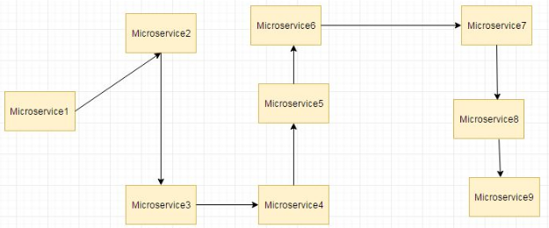
What is Hystrix?
And it is difficult to find which MicroService is down or caused the problem.

Slide 4
What is Hystrix?
suppose if the microservice 9 in the above diagram failed, then using the traditional approach we will propagate an exception. But this will still cause the whole system to crash anyways.
This problem gets more complex as the number of microservices increase. The number of microservices can be as high as 1000. This is where hystrix comes into picture- We will be using two features of Hystrix-Fallback method
Circuit Breaker

Slide 5
What is Hystrix?
Now suppose due to some reason the employee-producer exposed service throws an exception. In this case using Hystrix we define a fallback method. This fallback method should have the same return type as the exposed service. In case of exception in the exposed service the fallback method will return some value.

Slide 6
How to open Dashboard
Download Example: https://drive.google.com/file/d/1dtQDnvPM2RuPuvbA2u-jmamo09hkF3xZ/view?usp=sharing
For those who are using spring boot 2, the hystrix.stream endpoint has been moved to /actuator/hystrix.stream.
Give below URL in Browser
http://localhost:8082/hystrix
Then give below URL in text box in form
http://localhost:8082/actuator/hystrix.stream
And, have this actuator endpoint enabled via following property(in application.properties file):
management.endpoints.web.exposure.include=hystrix.stream

Slide 7
Circuit Breaker, How it works?
https://github.com/Netflix/Hystrix/wiki/How-it-Works
A service failure in the lower level of services can cause cascading failure all the way up to the user. When calls to a particular service exceed circuitBreaker.requestVolumeThreshold (default: 20 requests) and the failure percentage is greater than circuitBreaker.errorThresholdPercentage(default: >50%) in a rolling window defined by metrics.rollingStats.timeInMilliseconds (default: 10 seconds), the circuit opens and the call is not made. In cases of error and an open circuit, a fallback can be provided by the developer.
Having an open circuit stops cascading failures and allows overwhelmed or failing services time to recover. The fallback can be another Hystrix protected call, static data, or a sensible empty value. Fallbacks may be chained so that the first fallback makes some other business call, which in turn falls back to static data.

Slide 8
How to Customize behavior of Hystrix?
It is possible by using @HystrixProperty or thru application.properties
@HystrixCommand(fallbackMethod = "getDefaultProductInventoryByCode",
commandProperties = {
@HystrixProperty(name = "execution.isolation.thread.timeoutInMilliseconds", value = "3000"),
@HystrixProperty(name = "circuitBreaker.errorThresholdPercentage", value="60")
}
)
public String getProductInventoryByCode(String productCode)
{
....
}
Hystrix Configuration parameters/properties https://www.youtube.com/watch?v=1MPDOdFihPo
https://www.logicbig.com/tutorials/spring-framework/spring-cloud/hystrix-configuration-properties.html
https://medium.com/@darek1024/hystrix-circuit-breaker-how-to-set-it-up-properly-84c75cfbe3ee - Has clear explanation of each Hystrix command

Slide 9
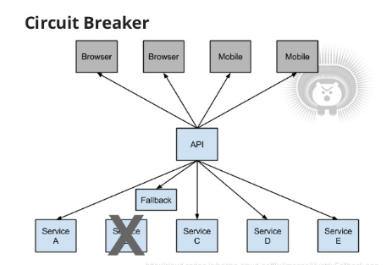
How to Customize behavior of Hystrix?
Instead of configuring these parameter values in the code we can configure them in bootstrap.properties/yml files as follows.
1 2 | hystrix.command.getProductInventoryByCode.execution.isolation.thread.timeoutInMilliseconds=2000 hystrix.command.getProductInventoryByCode.circuitBreaker.errorThresholdPercentage=60

Slide 10
Turbine
Instead of having a separate dashboard for every service we can use Turbine to provide a unified view of all services in a single dashboard.
Turbine provides a way to aggregate this information across all installations of an application in a cluster. Integrating turbine into a Spring-Cloud based application is straightforward, all it requires is information on which clusters to expose information on and how to aggregate information about the specific clusters.
POM file:
<dependency>
<groupId>org.springframework.cloud</groupId>
<artifactId>spring-cloud-starter-turbine</artifactId>
<exclusions>
<exclusion>
<groupId>javax.servlet</groupId>
<artifactId>servlet-api</artifactId>
</exclusion>
</exclusions>
</dependency>

Slide 11
Feign Client with fallback
Feign client with fallback
https://www.appsdeveloperblog.com/hystrix-circuitbreaker-and-feign/

